Slide 1
Java Modeling Language

Slide 2
Agenda
JML Expressions
FOL in JML
JML Quantifiers
Examples
JML & Inheritance

Slide 3
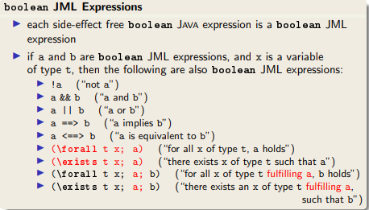
JML Expressions

Slide 4
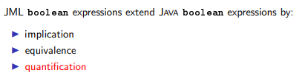
FOL in JML

Slide 5
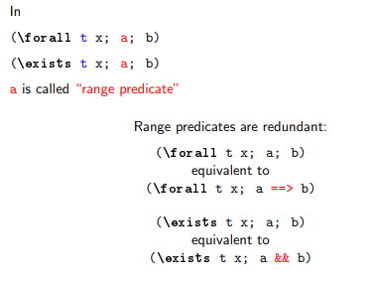
JML Quantifiers

Slide 6


Using Quantified JML expressions

Slide 7
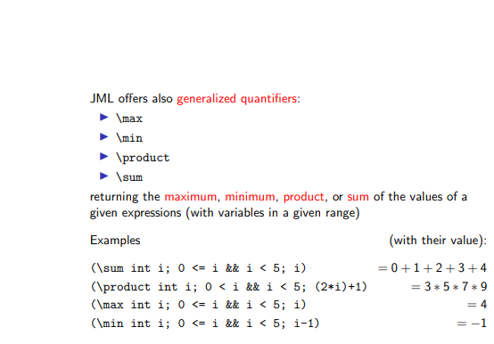
Generalized Quantifiers

Slide 8
Inheritance & JML

Slide 9
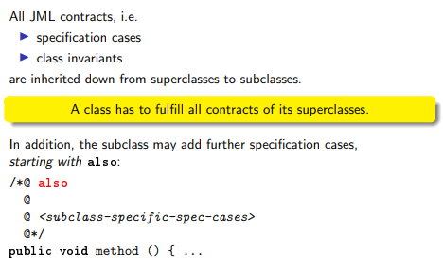
JML & Inheritance

Slide 10
Example 1

Slide 11
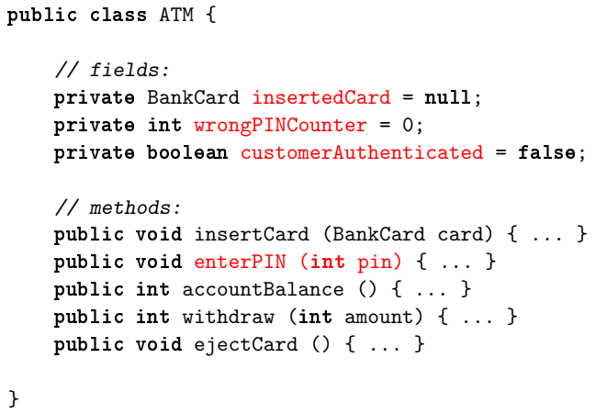
class BankCard {
protected Account account;
protected boolean invalid;
protected int correctPin;
}

Slide 12
Informal Specification
Very informal Specification of ‘enterPIN (int pin)’:
Checks whether the pin belongs to the bank card currently inserted in the ATM. If a wrong pin is received three times in a row, the card is confiscated. After receiving the correct pin, the customer is regarded as authenticated.

Slide 13
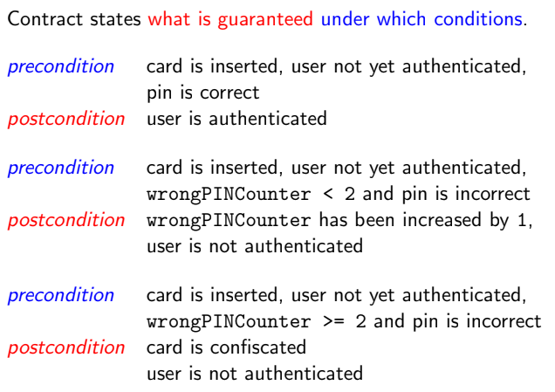
Getting more precise Specification as Contracts

Slide 14
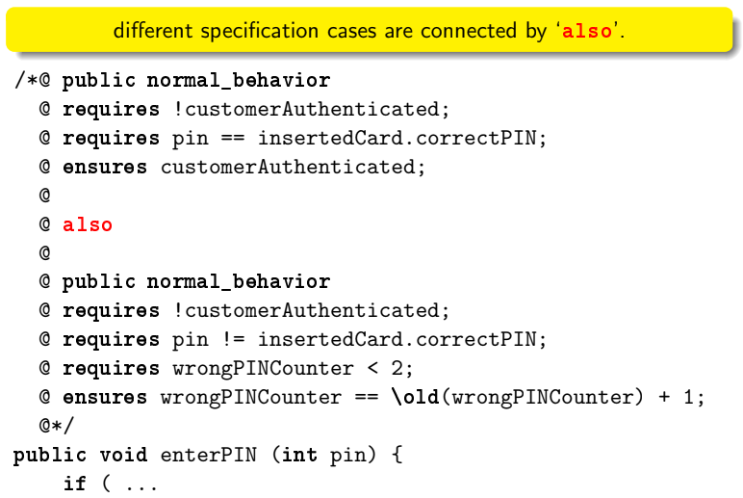
JML by Example

Slide 15
Getting more precise Specification as Contracts

Slide 16
JML by Example

Slide 17
Getting more precise Specification as Contracts

Slide 18
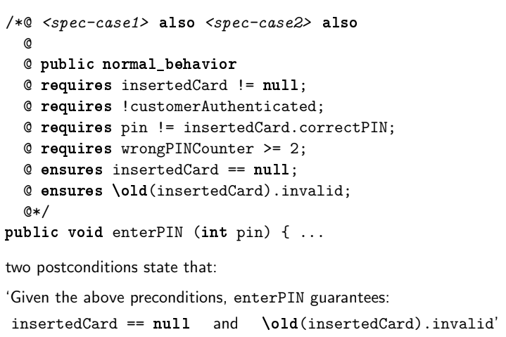
Contd.

Slide 19
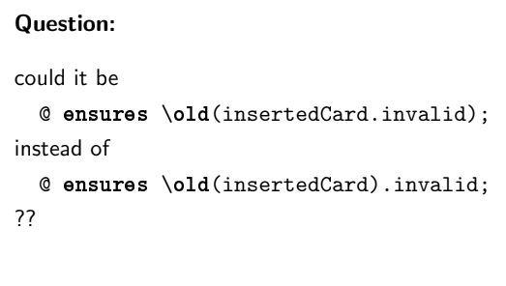
Contd.

Slide 20
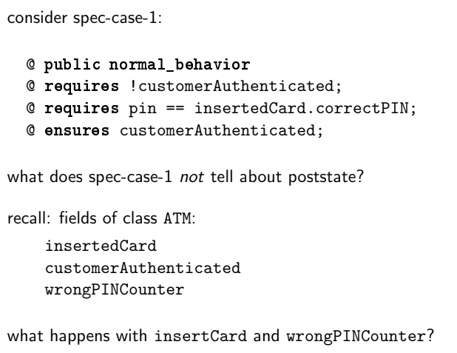
Are specification cases complete?

Slide 21
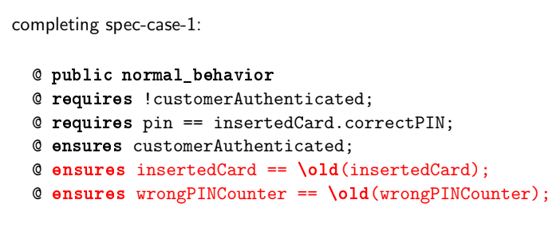
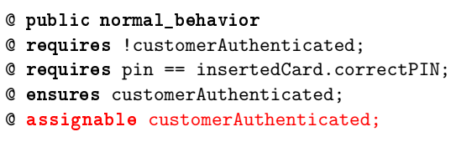
Completing spec-case-1
OR

Slide 22
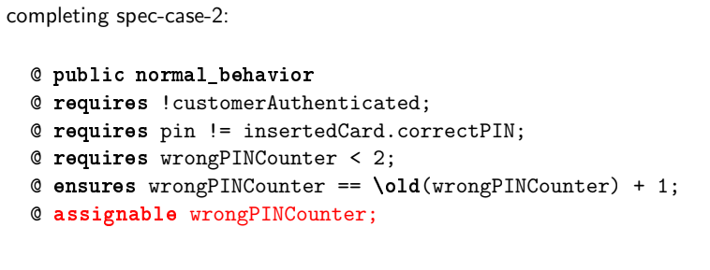
Completing spec-case-2

Slide 23
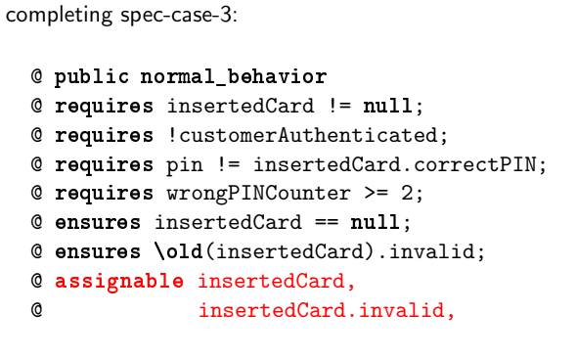
Completing spec-case-3

Slide 24
Deductive Verification
Using various tools, you can verify program specifications written in JML.
These tools specifically the KeY tool provide a theorem prover for Java, Modeling Language & Java Dynamic Logic based on a sequent calculus.
It allows for full functional verification of sequential Java

Slide 25
Formal Verification with KeY
JML annotations, Java programs, and the rules of symbolic execution are all translated automatically to formulas and rules of the program logic that is used by KeY.
It is not necessary to understand the details of this. Suffice it to say, when loading a class, annotated with JML contracts, into KeY, a proof obligation formula is generated and loaded into its theorem prover.
Then the user selects a method and its contract and attempts to show its validity.
If the theorem prover can show the validity of the proof obligation formula relating to a given contract and method, then we know the following is true:
If the method is started in any Java state that satisfies the requires clause, then upon termination, the final state satisfies the ensures clause.
KeY’s theorem prover provides a high degree of automation but allows also interactions by the user in case a proof cannot be found automatically.
Most often, interactions with the prover consist in providing additional annotations such as invariants.
If no proof is found, then the failed proof needs to be analysed as to whether the specification is too weak or wrong, the program is buggy or the automation is not powerful enough and further interaction by the user is required.

Slide 26
Additional References
KeY Verification Tool Tutorial Link
https://www.key-project.org/applications/program-verification/#Tutorials

Slide 27
THANK YOU!

